Slide 1

5G Network Slice
Ravi Shankar Prasad – M11202816
Tobias Erik Rosengren – E11302004

Slide 2
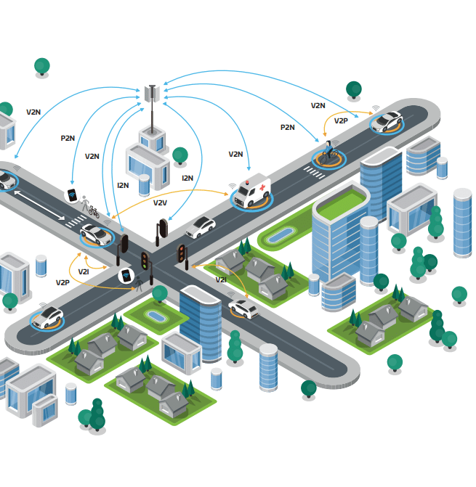
The V2X Challenge & 5G’s Solution
V2X (Vehicle-to-Everything) communication is vital for autonomus driving, traffic efficiency and safety
Demands stringent Quality of Service (QoS):
Ultra-low-latency
High reliability
High throughput for infotainment/maps
5G’s Promise:
5G is designed to support these demands, partially through Network Slicing
Network Slicing allows dedicated, isolated ”virtual networks” (slices) tailored to specific V2X services

Slide 3
Project Objective: Achieving V2X QoS
Primary Goal: To design, simulate and test a 5G network slicing implementation to demonstrate the possibility of achieving the strict QoS requirements
V2X: Moderate throughput (50-100 Mbps) but strict latency
eMBB: Highest throughput (1 Gbps) but variable latency
mMTC: Low throughput (<10 Mbps), bursty traffic

Slide 4



Methodology & Tools
Simulation Environment:
Core Network (5GC): Open5GS – Open-source implementation of 5G Core Network functions
Radio Access Network (RAN) / User Equipment (UE): UERANSIM – Open-source 5G gNodeB and UE simulator
Tools:
Wireshark
iperf3
MongoDB

Slide 5
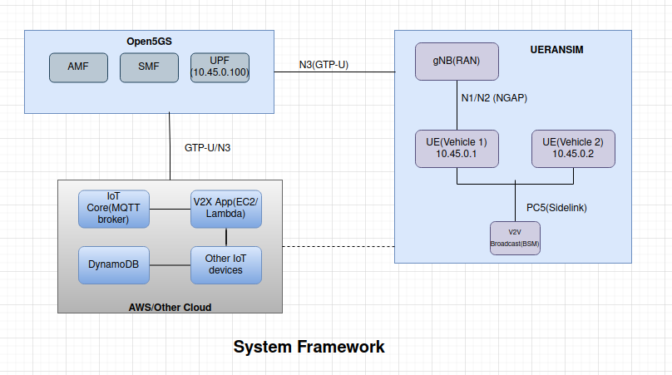
System Framework

Slide 6
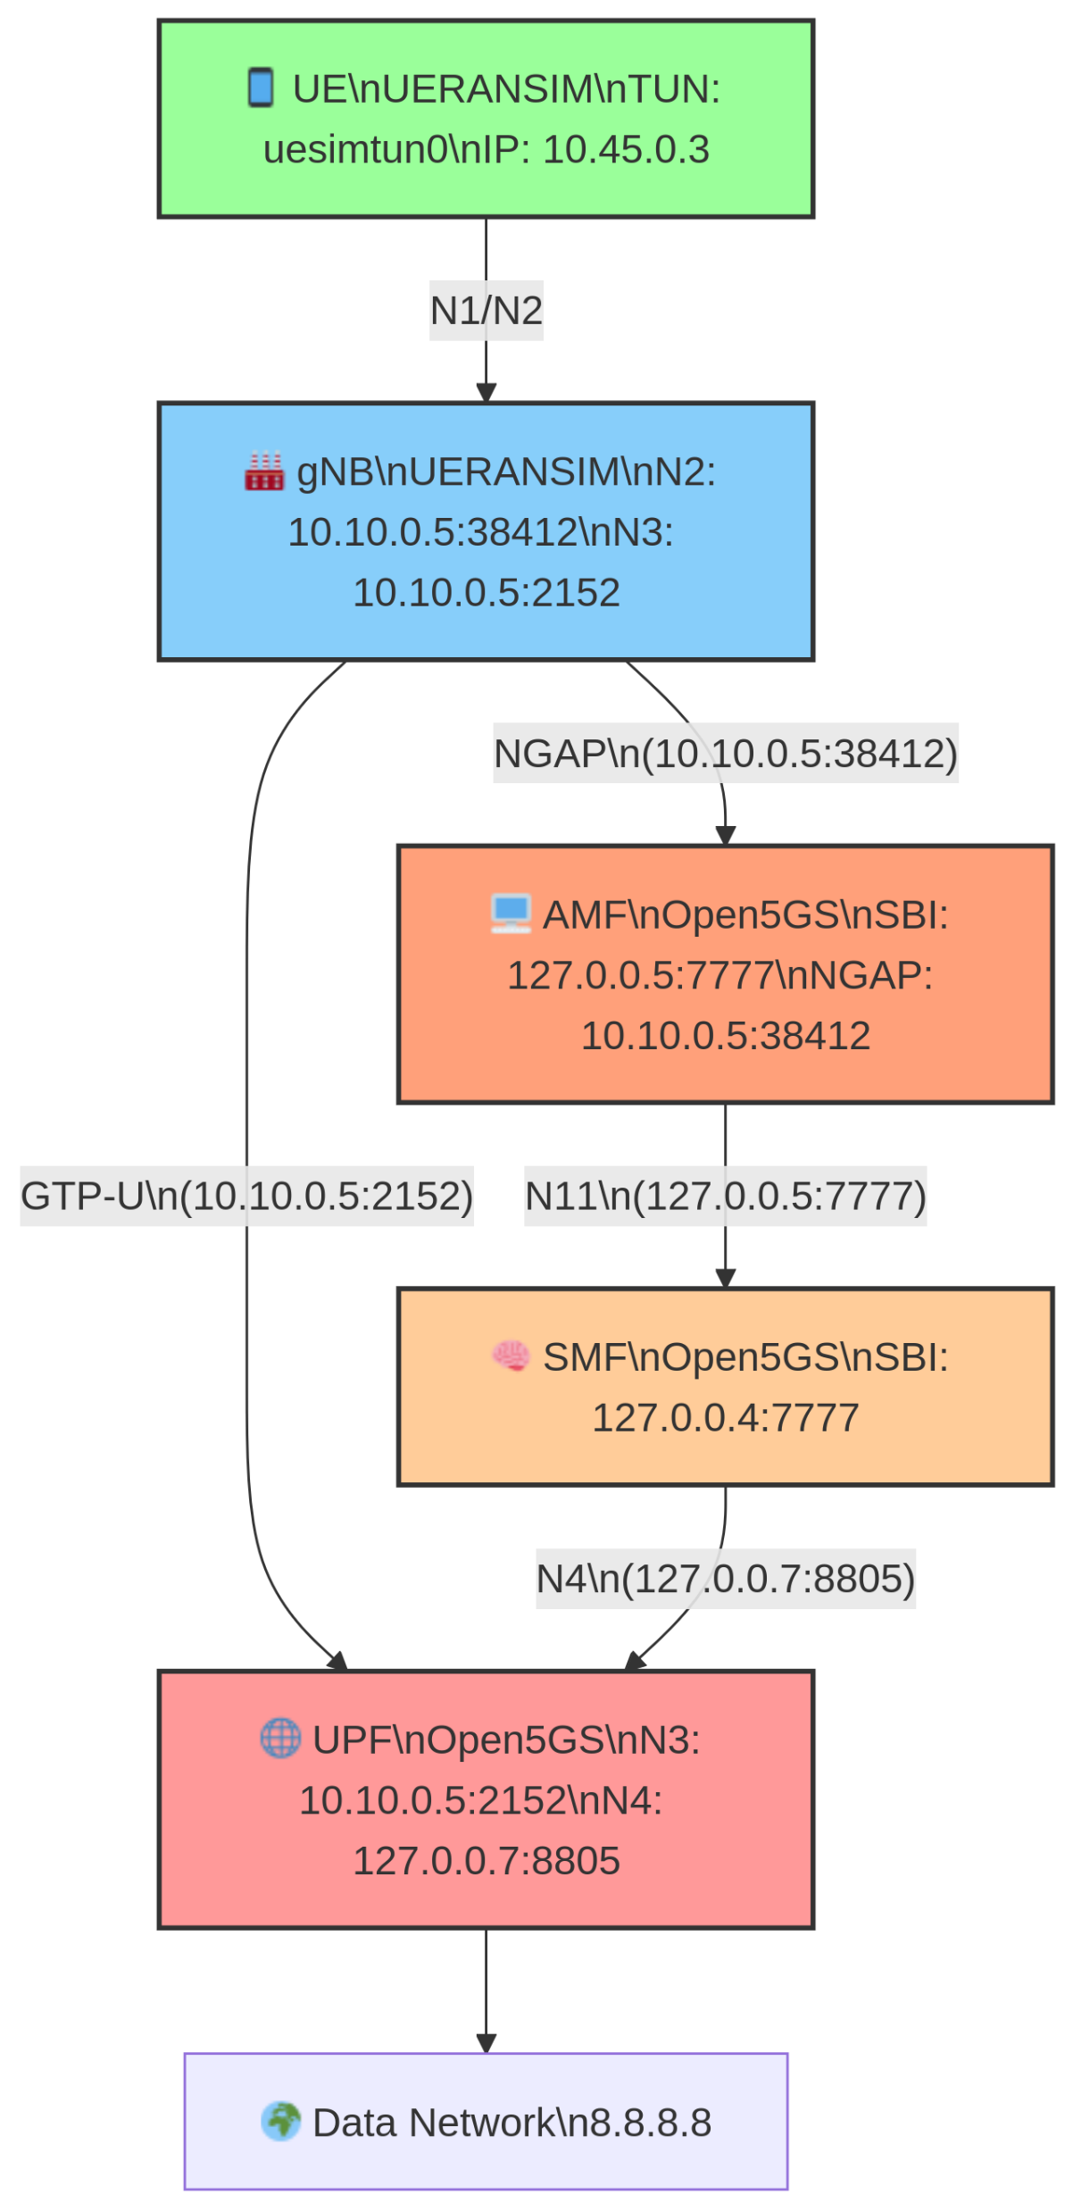
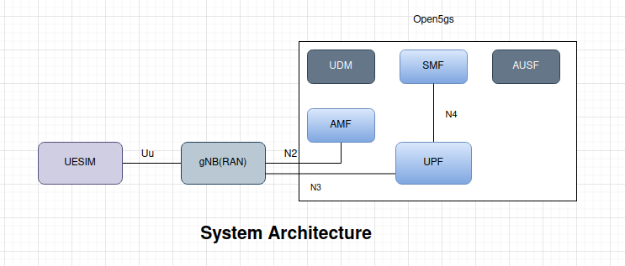
System Architecture

Slide 7
Target Metrics
Throughput:
V2X: Moderate throughput (50–100 Mbps)
eMBB: Highest throughput (∼1 Gbps)
mMTC: Low throughput (<10 Mbps), bursty traffic.
Latency
V2X: <10 ms (meets safety-critical requirements).
URLLC: 1–5 ms (industrial automation use case).
eMBB: 20–100 ms (tolerable for video streaming)

Slide 8
Results
Successful Core Network Operation:
Successfully built and configured Open5GS and UERANSIM components
5G registration and session establishment
V2X E2E Connections:
UE to open5GS
UE to UE
UE to AWS
UE to QEMU

Slide 9
Metric | UE1 – Host Machine (Loopback, Low-Latency Slice) | UE2 – VM (QEMU) (Bridged, High-Throughput Slice)
gNB IP | 127.0.0.1 (loopback) | 192.168.122.234 (VM bridge IP)
gNB → AMF IP | 127.0.0.5 | 192.168.122.1 (host IP)
UPF GTP-U IP | 127.0.0.7 | 127.0.0.7
Assigned UE IP | 10.45.0.2 | 10.45.0.5
Network Slice Type | SST: 1 (Low-latency slice) | SST: 1 (High-throughput slice)
Expected Latency | ≤ 10 ms (local loopback + low-latency slice) | ≤ 20 ms (bridged interface + high-throughput slice)
Achieved Latency | 1.3 ms (ping to 10.45.0.1) | 10% packet loss
Expected Throughput | ~80–100 Mbps | ~100–150 Mbps
Achieved Throughput | 92.4 Mbps (measured via iperf3) | 85 Mbps (no GTP-U traffic received by UPF)
PDU Session Status | Established | Established
uesimtun0 Assigned IP | 10.45.0.2 | 10.45.0.5
Ping to 10.45.0.1 | Success | 10% packet loss

Slide 10
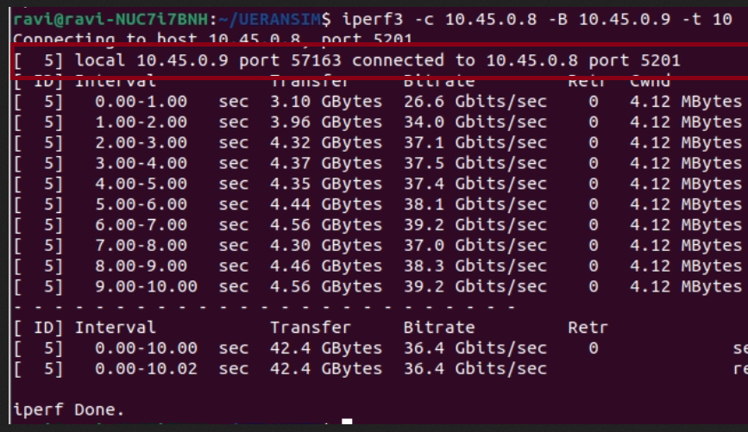
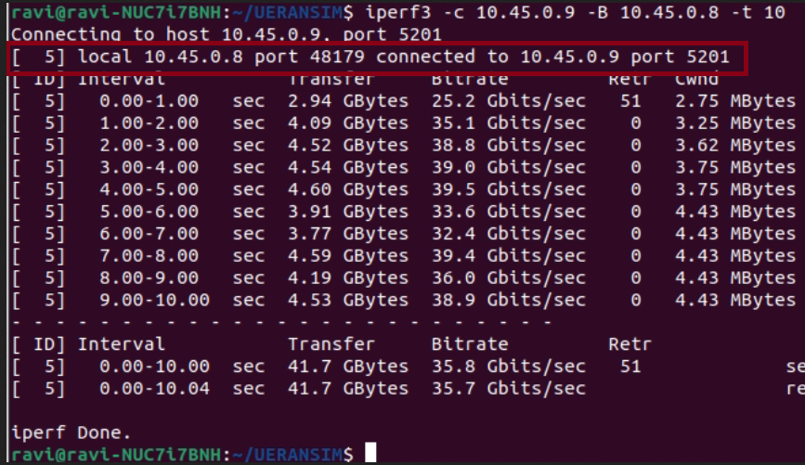
UE to UE

Slide 11
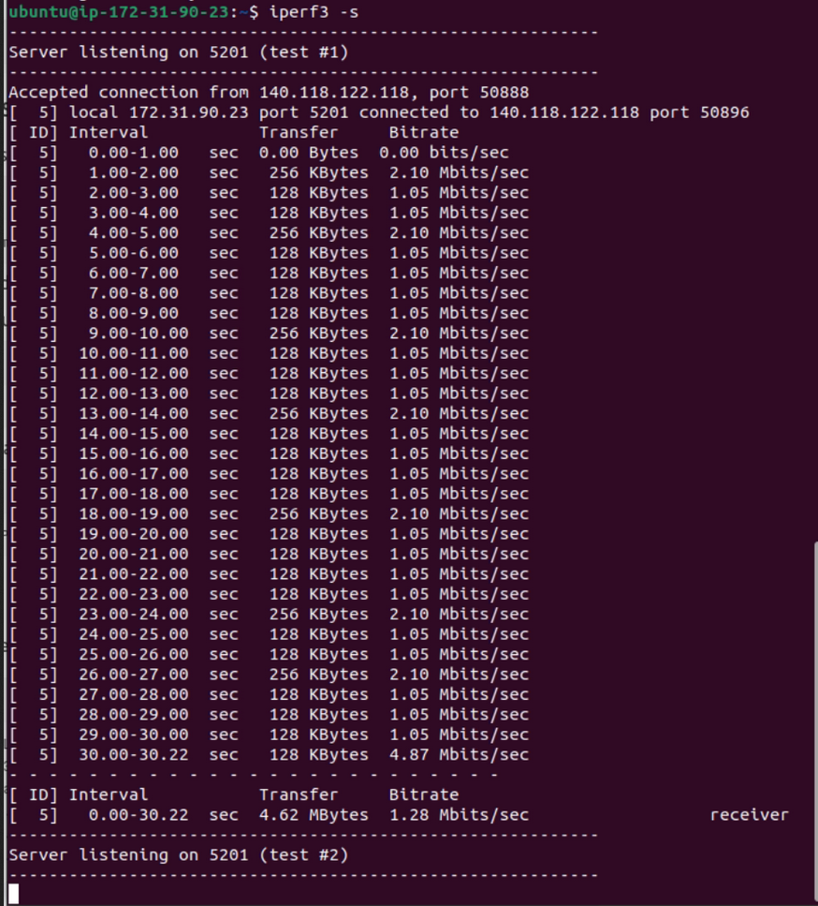
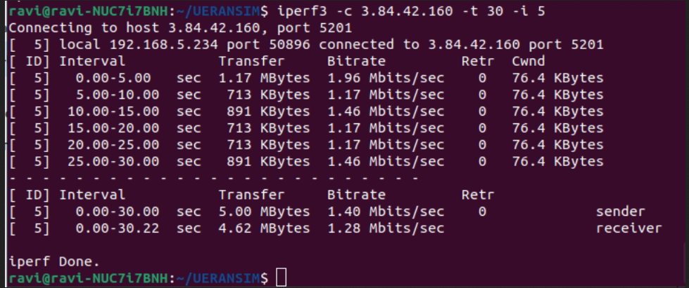
UE to AWS

Slide 12
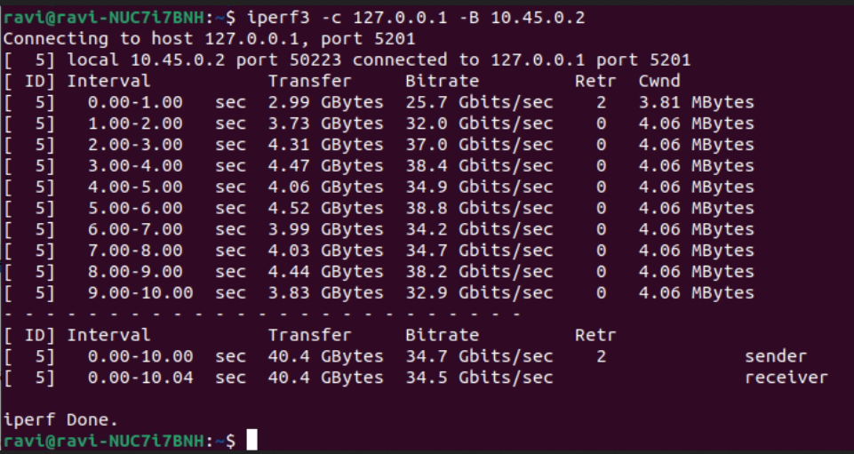
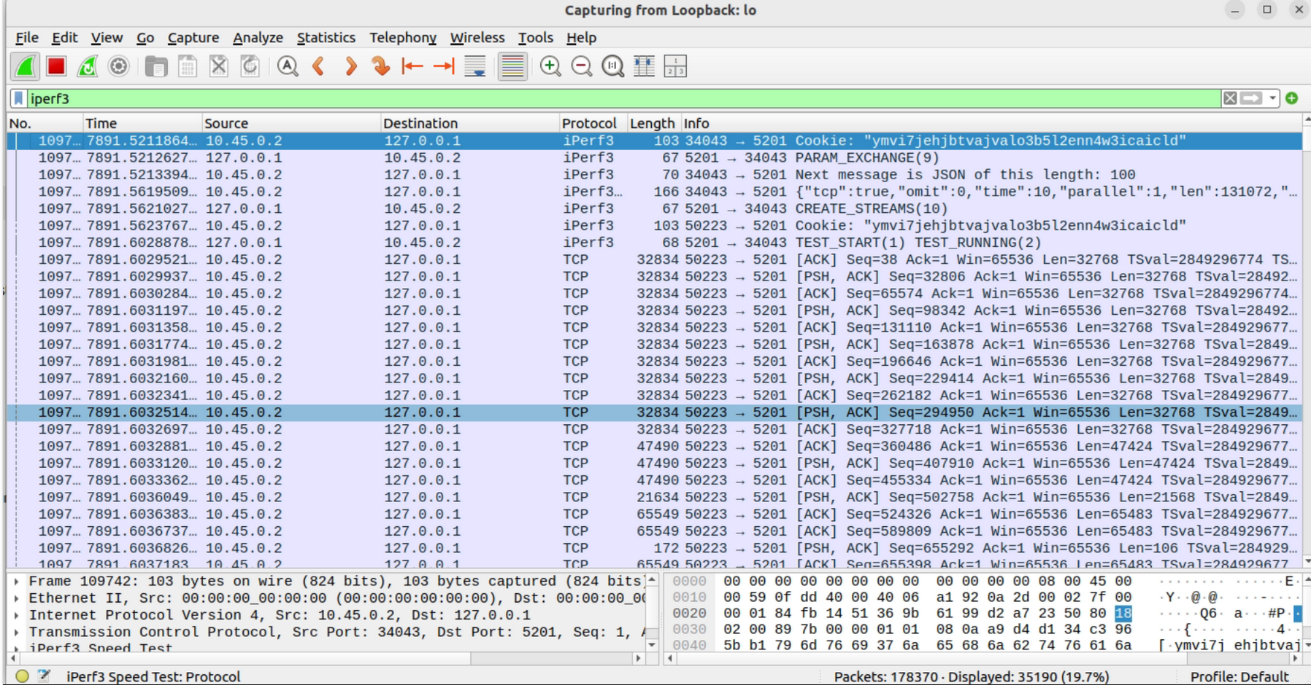
UE to Open5GS

Slide 13
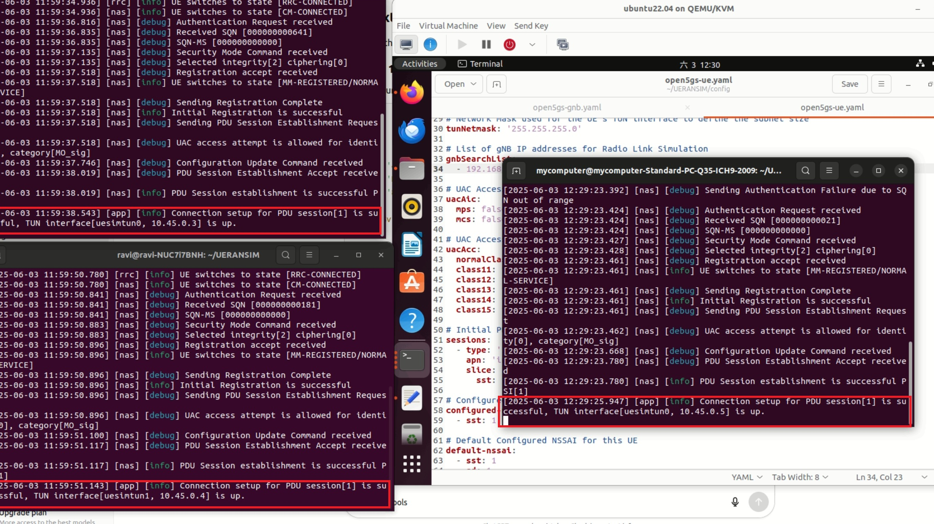
Qemu UE

Slide 14
Demo Outline
Open5gs and UERANSim system
UE to Open5GS connection
UE to UE connection
UE to IoT things
App hosted on AWS
One UE to UE with one UE hosted on QEMU

Slide 15

Demo

Slide 16
Discussion
Managed to setup a simple V2X 5G Network with simulated UE
VM Configuration issues and time constraints lead to the Network Slicing implementation not functioning correctly => Unfortunately cannot verify target metrics throughput and latency in Network Slicing
Open5GS: It is possible to replace 5G Core with free5GC instead

Slide 17
Conclusion and Future Work
Conclusion:
Sucessfully designed, simulated and validated a simple 5G network framework for V2X communications
Using Open5GS and UERANSIM, demonstrated feasability of 5G Networks for V2X
Future Work:
Troubleshoot and correctly implement network slicing
Explore dynamic slice management for real-time traffic fluctuation
Integrate with more realistic traffic models

Slide 18
References
Mendes, B., Araújo, M., Goes, A., Corujo, D., & Oliveira, A. S. (2025). Exploring V2X in 5G Networks: A Comprehensive Survey of Location-Based Services in Hybrid Scenarios. Vehicular Communications, 100878.
Github: https://github.com/ontherays/5G_network_Slice_iiotntust

Slide 19
Thank you for listening

